Slide 1

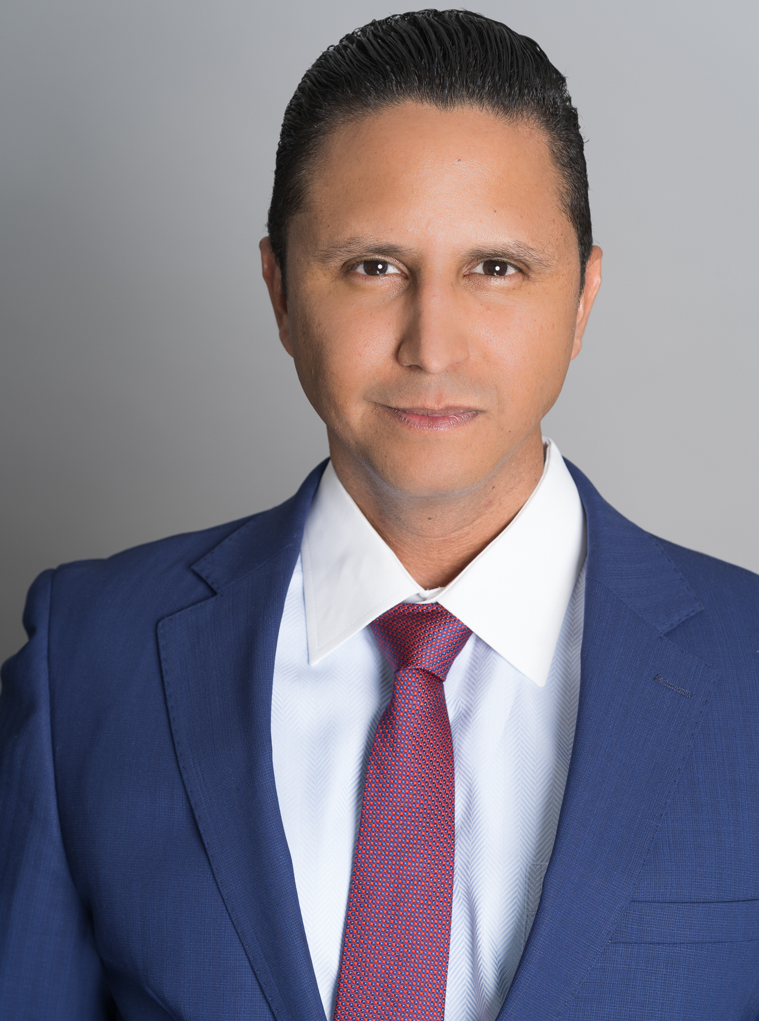
Fund Price Prediction
Jhonathan David Shaikh, MBA
Data Scientist, Flat Iron School NYC Campus
August 20, 2023
An MVP Model Time Series for Testing Purposes
~Not Investment Advise~

Slide 2
Start
Mid
Finish
Problem
Solve
Results
Business and Problem Understanding
Recommendations -1 Dataset Analyzed
- Models & Methods
Business

Slide 3

Steps to get you Results
5. Conclusion Plan for the Future and Maagement Plan
4. Models & Methods
ARIMA & SARIMAX
3. Assesing Data Set Time Series Components Decomposition
2. Technical Approach Model Forecasting
1. Understading Your Needs & Dataset
Problem /Solution

Slide 4

Understanding Your Needs, and Dataset
01

Slide 5

Problem
Solution
Predicting Fund Prices i.e. AMECX Fund Projection
Finding the right Partner
Technical – MVP Model Time Series Forecasting 1 year of Fund price
Discovery of what is needed to standarize future Modeling
Notes:
Today We’ll take the ACE

Slide 6
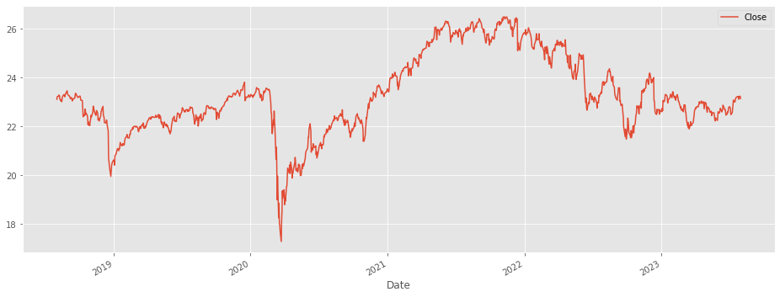
Broad Understanding
5 year Price History & Stats
Mutual Fund Broad view
$20,000
The Income Fund of America
AMECX
Ratings
AAA-A
33%
BBB-B
55%
Graph
U.S.T
10%
$23. Avg. Price
Std.Deviation $1.62
Dataset Broad view
1257
$26.50 Max
$17.29 Min
5 years
August 1st 2018-2023
Indexed Rows

Slide 7

Modeling Technical Components
02

Slide 8
Components of the Technical Solution
1) The Dataset
2) Dataset Preparation
3) Set up for Forecasting
4) Modeling Forecast
AMECX
EDL, Data Preparation (Indexing, TS transformation )
Decompostion & Stationarity
Assesing Trends
-Asseses -->Stationarity & Decomposition→ Differencing
-Auto Correlation (ACF)
-Partial Autocorrelation (PACF)
-Steps
-Model Fit
-AIC
-Root Mean Square Error
-Forecasting

Slide 9

Assesing Dataset
03

Slide 10
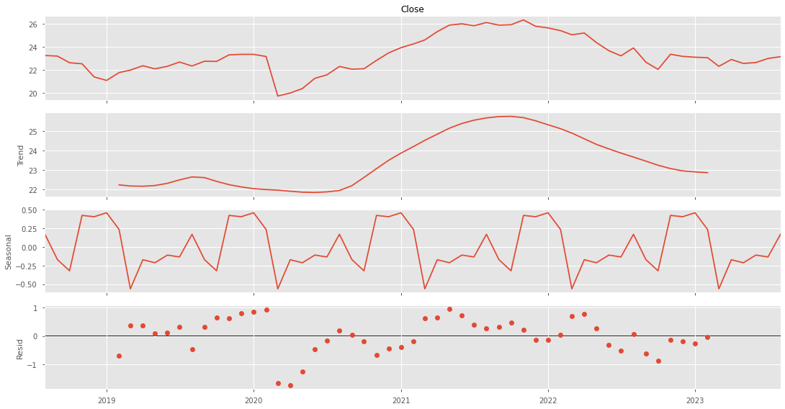
Monthly Decomposition of AMECX
Assessing Dataset
Data
Trend
Seasonality
Residual

Slide 11
Applying Components for Predictions
Data Prepared
Asses Trends
Test Stationarity
i.e. Dickey Fuller Test
Right Model Parameters
ACF/PACF
Predictions
Assessing Trends
Testing Stationarity
Difference Data to make it more Stationary
Understand Auto Correlations and Partial Auto Correlations
5. Run Models, test best with AIC, and RMSE> conduct Predictions

Slide 12
Models Methods Projection
04

Slide 13
Models
MODEL NAME
AIC
RMSE
AR/MA_1
101.09
1.23
AR/MA_2
102.91
1.27
ARIMA
102.44
1.46
SARIMAX
99.855
1.04

Slide 14
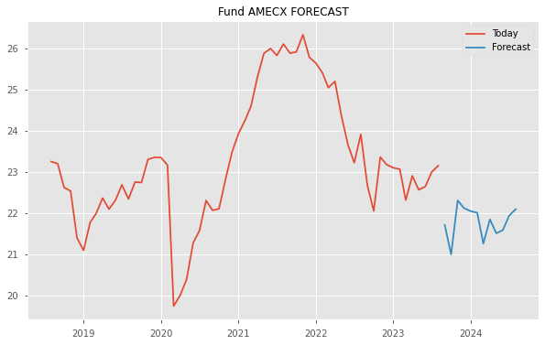
SARIMAX- 1 year projection price range US$21-$22.25

Slide 15

Conclusion:
05

Slide 16

Time Series Reproducibility with additional success components
Capturing the right timing
Conducting testing
Choosing Portfolio Addressing multiple funds
Time series adapted to the right fit of time.
Testing starts with AMECX.
Over 8,000 funds available.

Slide 17

Thanks
Does anyone have any questions?
addyouremail@freepik.com
+91 620 421 838
yourcompany.com

Slide 18
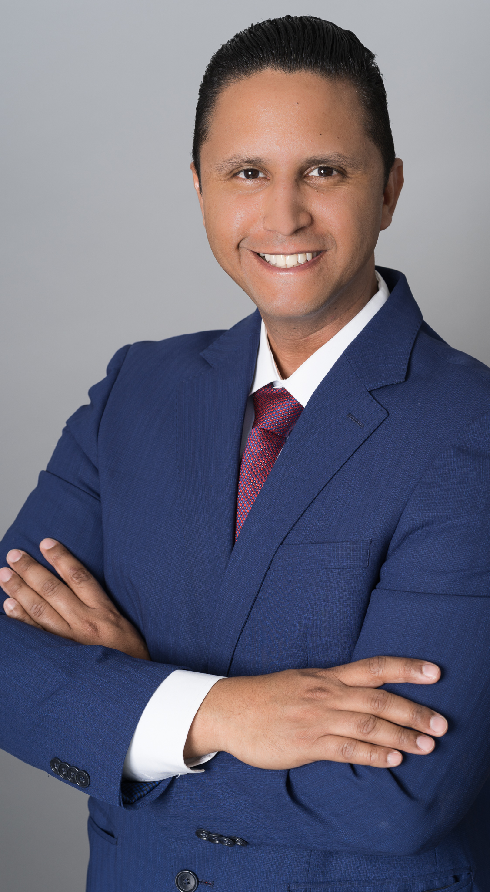

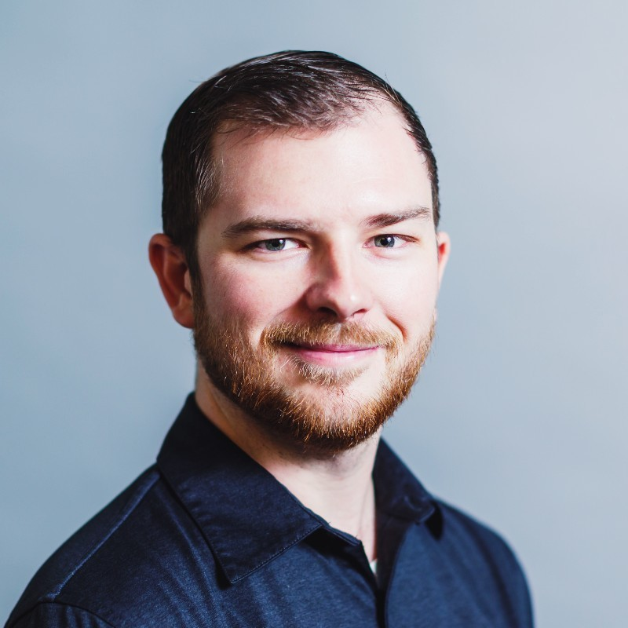

Fabolous Team ! Do Business with us!
Data Scientist, Administration
Charles Jones
Data Scientist, Design
Mark
Morgan
Mark DoeMark
Jhonathan

Slide 19
Our Pricing
$100K
120 Hours
$20 MM * 0.04 =$800,000
Your benefit
Assessing Funds
Finding Data Sets
MVP Models
Research
Model Validation
Model Documenting

